Slide 1
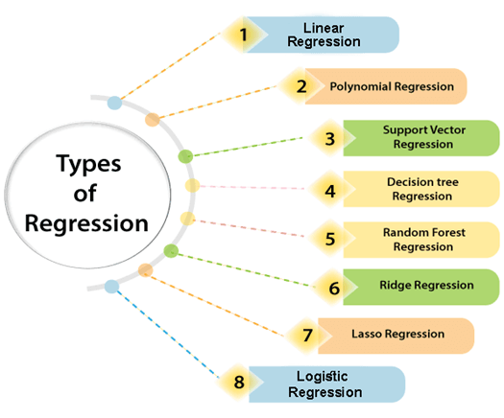
Regression
For example, house prices are a continuous value that depends on the features of the house.
The goal of the model is to predict the prices based on the features (no of bedrooms, area, etc.).
shorturl.at/yBI35
Notes:
There are various types of regressions which are used in data science and machine learning. Each type has its own importance on different scenarios, but at the core, all the regression methods analyze the effect of the independent variable on dependent variables. Here we are discussing some important types of regression which are given below:

Slide 2
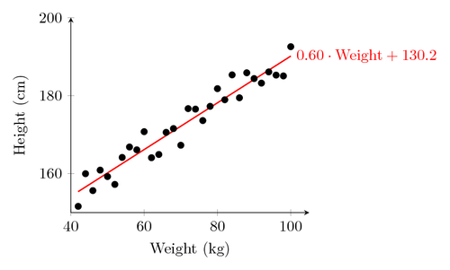
Linear Regression
Simple Linear Regression
x - the independent variable
h(x)- the dependent variable (predicted output)
To find Q0 and Q1( coefficients)-> (h(x)-y)- minimum
Y – the true dependent variable
h(x) = Q0 + Q1*x
Notes:
Simple Linear Regression is a regression machine learning algorithm that focuses on finding the relationship between two continuous variables.
The variable which helps in prediction is the independent variable whereas the variable which is being predicted is called the dependent variable.
The relationship between the two variables is the statistical one, which means the variables may not be completely accurate in determining the relationship between them.
For example, the relationship between the salary and years of experience of an employee.
You cannot determine the salary of an employee accurately just by considering his years of experience.
The goal of the simple linear regression is to find the line that fits the data best and the overall error is low, meaning the distance between the line and the data points is minimum.
where Q0 and Q1 are parameters of the regression equation, x is the independent variable, and h(x) is the predicted output. Our goal is to find the values of Q0 and Q1 such that the value of (h(x)-y), y being the true dependent variable, is minimum. We want the difference between the predicted value and the true value to be minimum to get the best line that passes through almost all the data points.

Slide 3
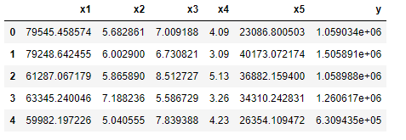
Linear Regression
Multivariate Linear Regression
In MLR, we use multiple variables to predict the outcome of the dependent variable.
The cost of a house, area, rooms, balconies, etc.
h(x) = Q0 + Q1*x1 + Q2*x2 + Q3*x3 +……..+Qnxn
Notes:
Multivariate Linear Regression is a machine learning algorithm in which we use multiple variables to predict the outcome of the dependent variable. This algorithm is an extension of the simple linear regression. We have more than one independent variable which is used for the prediction of the dependent variable. For example, while calculating the cost of a house, we take the area, number of rooms, balconies, etc. into account for a better and more accurate result.

Slide 4
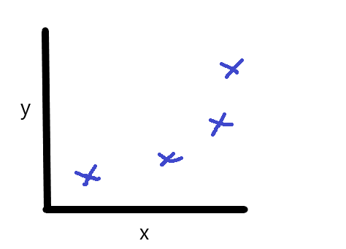
Polynomial Regression
h(x) = Q0 + Q1*x + Q2*x² +…Qn*x^n
The relationship between independent and dependent variables as the nth degree of a polynomial.
The polynomial regression fits the non-linear relationship between x, and y.
Notes:
Polynomial Regression is another type of regression algorithm in which the relationship between independent and dependent variables is modeled as the nth degree of a polynomial. The polynomial regression fits the non-linear relationship between the independent variable, x, and the dependent variable, y.
In the above diagram, data points have been placed which represent the relationship between x and y. Let’s now apply simple linear regression to find a line that fits the data.

Slide 5
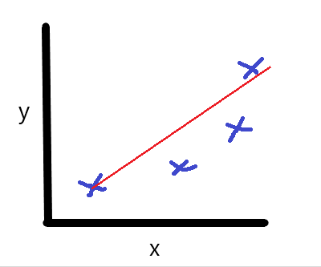
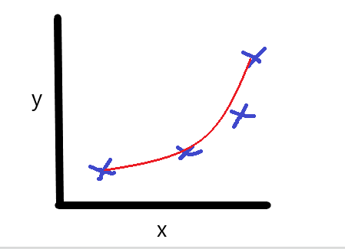
Polynomial Regression
Simple Linear Regression failed to provide the best fit line for the data (left).
The polynomial regression is quite optimum since it fits almost all the data points and the error rate is at its minimum (right).
Notes:
We can see that Simple Linear Regression failed to provide the best fit line for the data since the data points are quite far away from the line and the error rate is quite high. Now, let’s try fitting the same dataset with the help of the polynomial regression model.
The line (or curve) obtained using polynomial regression is quite optimum since it fits almost all the data points and the error rate is at its minimum. This is why when the two variables have a non-linear relationship, we use the Polynomial Regression algorithm.

Slide 6
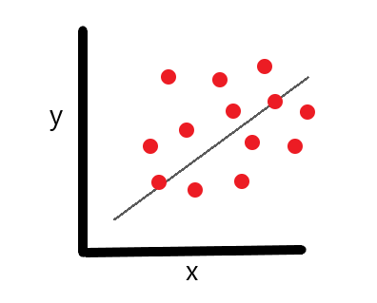
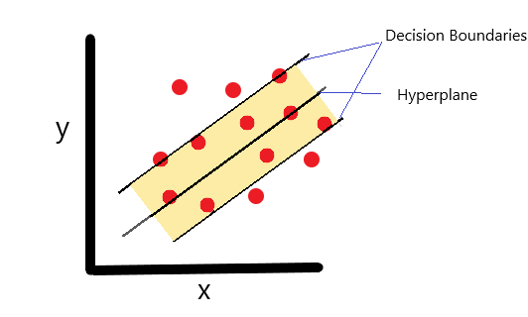
Support Vector Regression
In SVR, the data points lying within boundaries |a| are disregarded from the error point of view.
Y = wx + b
-a < Y- (wx+b) <+a
from sklearn.svm import SVR
regressor = SVR(kernel = 'rbf')
regressor.fit(X, y)
shorturl.at/cltJN
Notes:
In the above diagram, we can see the line fits a few points and it’s not the best line.
Now, in SVR, we form two lines on either side of the given line, and the data points lying within it are disregarded from the error point of view. The lines around the best fit line are called decision boundaries and the best fit line is called a hyperplane.
The tube-like structure that we see above is called the insensitive tube because the data points present in this tube are ignored from the error point of view. Let’s consider the two decision boundaries are at a distance of |h| from the hyperplane, the upper decision boundary is at a distance of ‘+h’ and the lower decision boundary is at a distance of ‘-h’ from the hyperplane.

Slide 7
Performance Metrics
The performance metrics used for evaluating a regression model:
  Mean Absolute Error (MAE)
  Mean Squared Error (MSE)
  Root Mean Squared Error (RMSE)
  R-Squared
  Adjusted R-squared
shorturl.at/aiyIV

Slide 8
Applications
Forecasting, risk assessment analysis in health insurance companies and requires minimal tuning.
Dataset: shorturl.at/qG149
shorturl.at/jxBCZ
  sklearn_simple_linear_regression_big_mac_index.ipynb

